Slide 1
BRANCH : B.TECH C.S DIVISION : B BATCH : B-1
TEAM MEMBERS
SMIT DOSHI
REETIKA CHAUDHARY
PRAYASHI BOHRA
DEEPAK DEWANI

Slide 2

EXPENSE MANAGER
A budget manager is an application (or a tool) that helps us to calculate and maintain our expenditure, monthly, weekly, or even daily.

Slide 3
DESCRIPTION
Everyone faces a lot of problem to maintain their budget and stick to it. Therefore, the budget manager is an application which calculates their expenses and maintains a record of it. By this the user has a thing less to worry about!

Slide 4
DESCRIPTION(Contd)
In the initial attempt of the app, it calculates the expenses in different categories out of our budget stored monthly and then displays it accordingly.

Slide 5
FUNCTIONALITY IN BRIEF
In the initial attempt of the app, it calculates the expenses in different categories out of our budget stored monthly and then displays it accordingly.
The application allows the user to select different categories for the budget.
There are two pages in the application which are explained in the next slides.

Slide 6
PAGE “1”
On page 1 of the application, the user enters his/her monthly income in the income text-field.
Following the income, the user enters his/her total expenses in the expense field.
The applications will then calculate remaining expense amount for the user and displays it on the screen.
After this, the user then has the option to select his desired category to enter the expense for.

Slide 7
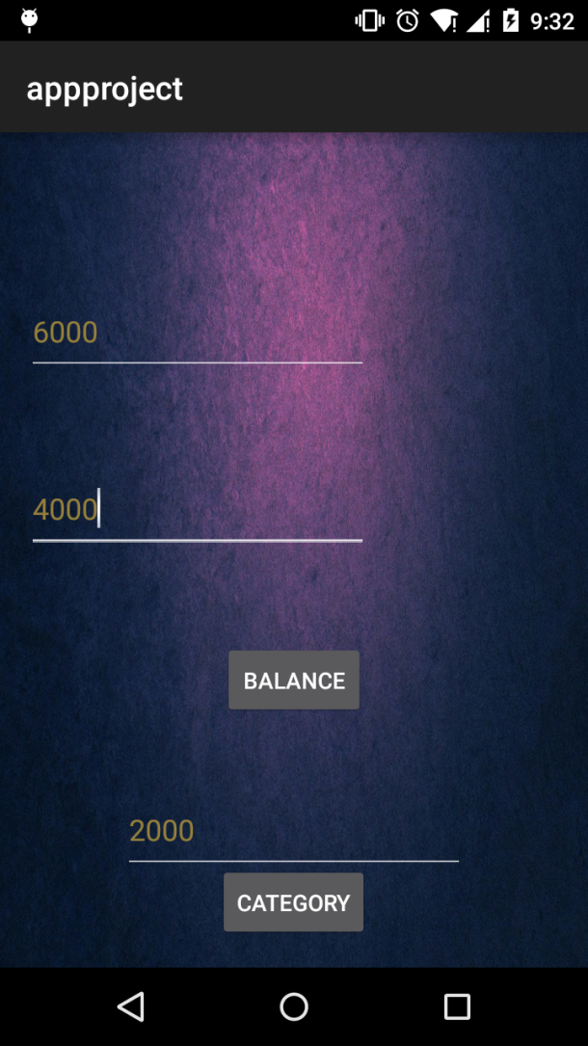

Slide 8
PAGE “2”
The application uses spinners and toast(explained later) on page 2.
Page 2 is all about selecting different categories to enter the expense .
User can select a category accordingly like food ,drink, fuel etc.
After selecting the category, the user enters the expense for the selected category.

Slide 9
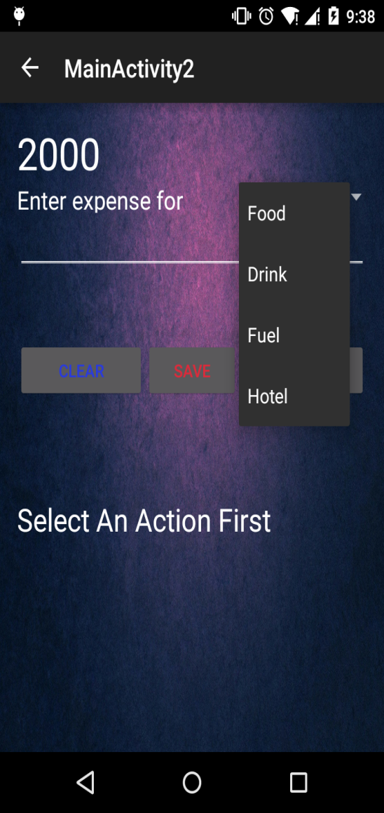

Slide 10
SPINNER
Spinners provide a quick way to select one value from a set. In the default state, a spinner shows its currently selected value.
Touching the spinner displays a dropdown menu with all other available values, from which the user can select a new one.

Slide 11
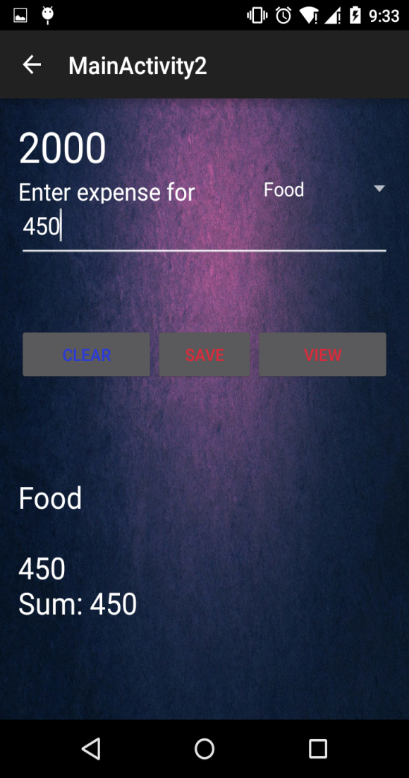

Slide 12
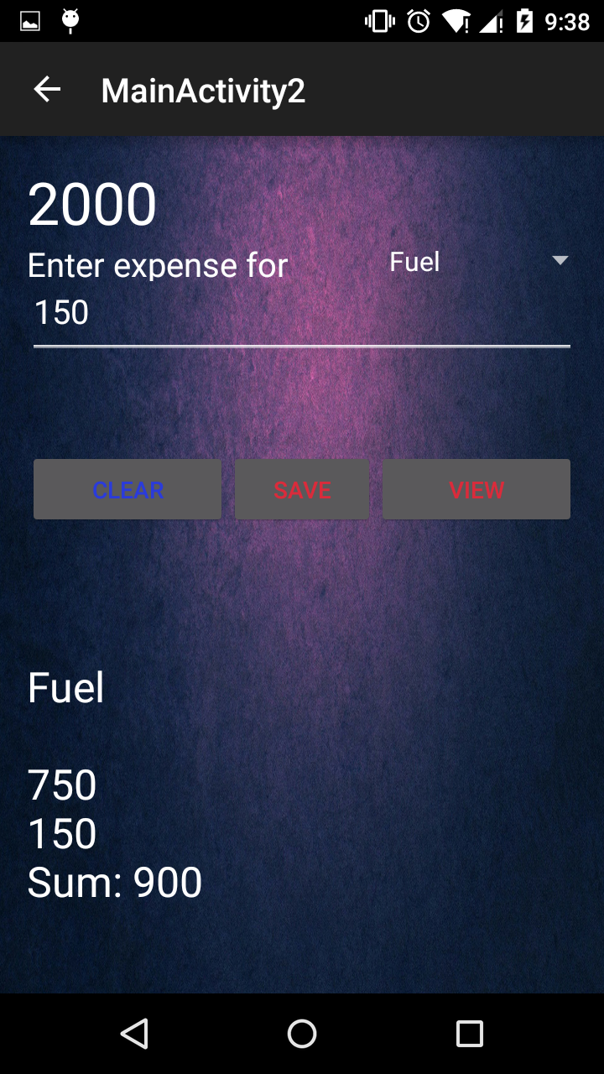

Slide 13
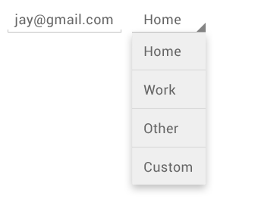
You can add spinner to your layout with spinner object.
You should usually do so in your XML layout with a <spinner> element.
Example:
<spinner
android:id="@+id/planets_spinner" android:layout_width="fill_parent" android:layout_height="wrap_content" />

Slide 14
Toasts
A toast provides simple feedback about an operation in a small popup.
It only fills the amount of space required for the message and the current activity remains visible and interactive.
Its just like a draft message and they automatically disappear after a timeout.

Slide 15
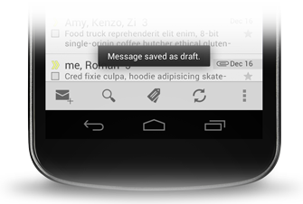
For example, navigating away from an email before you send it triggers a Draft saved" toast to let you know that you can continue editing later.
If user response to a status message is required, consider instead using a notification .

Slide 16
Syntax
Context context = getApplicationContext(); CharSequence text = "Hello toast!"; int duration = Toast.LENGTH_SHORT; Toast toast = Toast.makeText(context, text, duration); toast.show();

Slide 17
SHARED PREFERENCES
Shared Preferences allow you to save and retrieve data in the form of key-value pair.
In order to use shared preferences , you have to call a method getSharedPreferences() that returns a SharedPreference instance pointing to the file that contains the values of preferences.
Syntax:
Editor editor = sharedpreferences.edit(); editor.putString("key", "value"); editor.commit();

Slide 18
You can save something in the sharedpreferences by using SharedPreferences.Editor class. You will call the edit method of SharedPreference instance and will recieve it in an editor object

Slide 19
FUTURE SCOPE
Application will allow to set budget as well as allow to set limit of the budget.
It can be used for maintaining the records of your expenditure.
It might have this especial provision in which you save the total expenditure for the month and the application will inform the user if it’s exceeding the limit.

Slide 20
It allows to view data category wise.
It represent the data using line chart

Slide 21
THANKYOU!

